Slide 1
MOVIES ANALYTICS REPORT
Prepared by
B.SRIJESH REDDY
2211CS010395

Slide 2
Introduction
• Movie analytics involves analyzing movie datasets to gain insights into trends, genres, ratings, and revenue.
• It helps production companies, streaming platforms, and analysts understand audience preferences.
• The dataset analyzed here includes 1M movie records with fields like title, genre, rating, director, and budget.

Slide 3
Importance of Movie Analytics
• Identify popular genres and production trends.
• Analyze box office performance relative to budget.
• Evaluate director and actor influence on ratings.
• Understand historical patterns and predict success.
• Optimize marketing and release timing decisions.

Slide 4
Python Source Code Overview
• Analysis performed using PySpark for big data handling.
• Data cleaning: duplicates removed, missing values handled.
• Transformations: genre exploded, year extracted from release date.
• Aggregations: top genres, rating averages, and director performance.
• Visualizations: Matplotlib & Seaborn for plots.

Slide 5
Outputs & Key Results
• Drama, Action, and Comedy are top genres.
• IMDb ratings cluster between 6 and 8.
• Top directors produce significantly more high-rated movies.
• 1990s and 2010s were peak decades for movie releases.
• Higher budgets generally correlate with higher global box office revenue.

Slide 6
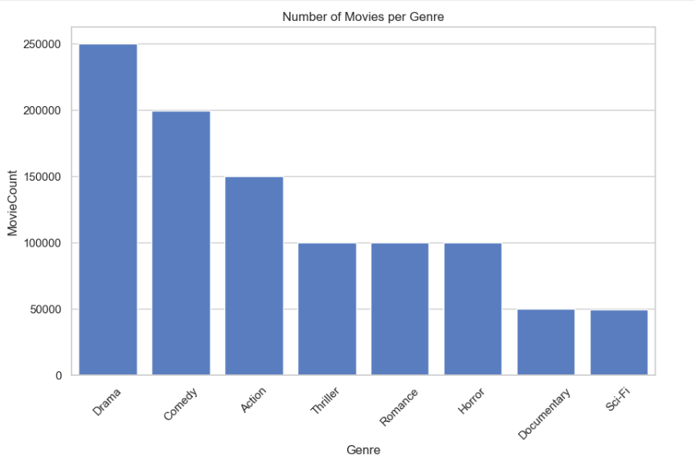
Example Visualizations
• Bar chart: Number of movies per genre.
• Line plot: Movies released per year.
• Histogram: IMDb rating distribution.
• Scatter plot: Budget vs Global Box Office.
• Bar chart: Top directors by number of movies.

Slide 7
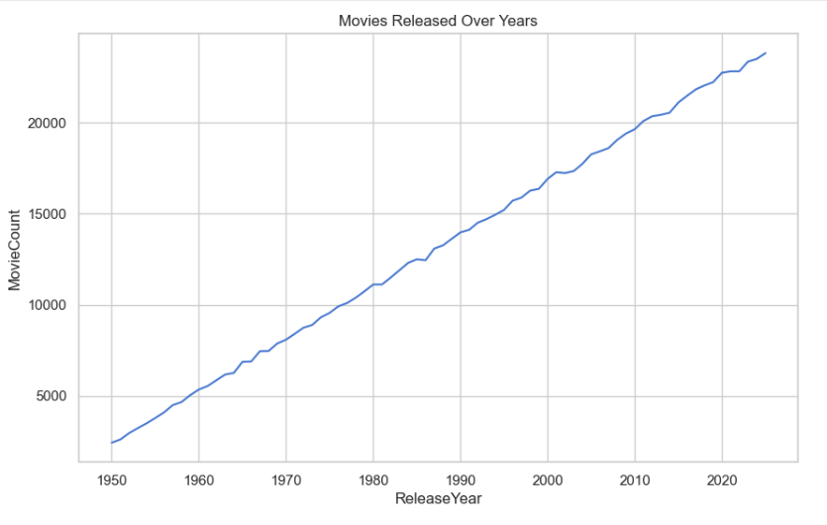

Slide 8
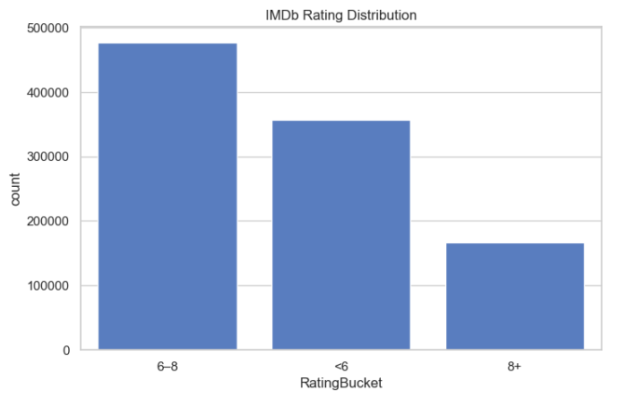

Slide 9
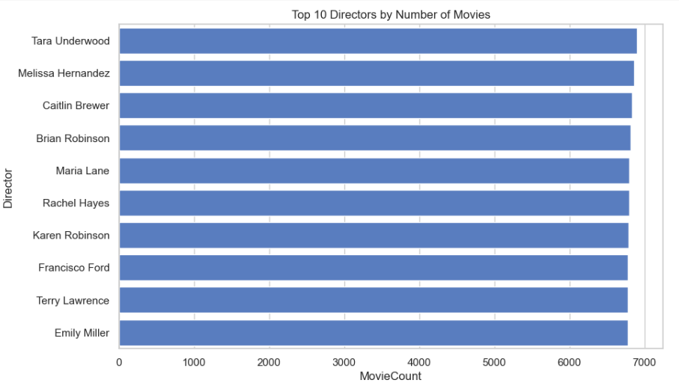

Slide 10
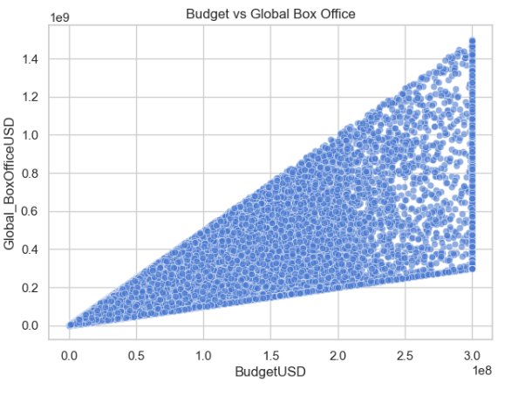

Slide 11
Tools Used
• PySpark for data processing
• Python (Pandas, Matplotlib, Seaborn)
• Power BI / Tableau for visualization dashboards
• Excel / SQL for quick summaries
• Cloud storage and ETL pipelines for scalability

Slide 12
Challenges
• Data inconsistencies in movie release years and formats.
• Missing or incorrect financial data (budget, revenue).
• Integrating multiple data sources for directors and genres.
• Handling very large datasets efficiently.
• Ensuring reproducibility and visualization clarity.

Slide 13
Conclusion
• Movie analytics enables data-driven storytelling and production decisions.
• Insights from ratings, genres, and box office data can guide future film strategies.
• Advanced analytics and ML models can predict movie success.
• The approach combines data engineering, statistics, and creative intuition.

